Slide 1
Scooter Morris
Nadezhda Doncheva
May 31, 2016
EMBO Practical Course
Budapest, Hungary

Slide 2
Outline
Biological Networks
  Why Networks?
  Biological Network Taxonomy
  Analytical Approaches
  Visualization
Introduction to Cytoscape
Hands on Tutorial
  Data import
  Layout and apps
Notes:
EDIT: schedule

Slide 3
Introductions
John “Scooter” Morris
  2010-Current
    Adjunct Assistant Professor, Pharmaceutical Chemistry
  2004-Current
    Director, NCRR Resource for Biocomputing, Visualization, and Informatics (RBVI) @ UCSF
  1985-2004
    Principal Systems Architect: Genentech, Inc.
  Cytoscape core team since 2006
  Author of several Cytoscape plugins
    SFLDLoader, structureViz, clusterMaker, chemViz, metanodePlugin, groupTool, commandTool, bioCycPlugin
Notes:
EDIT: introductions per presenter

Slide 4
Introductions
Nadezhda T. Doncheva
  2016-Current
    Postdoc researcher at the Novo Nordisk Foundation Center for Protein Research & Center for non-coding RNA in Technology and Health in Copenhagen
  2010-2016:
    Research scientist and PhD student at the Max Planck Institute for Informatics in Saarbrücken
  Author or co-developer of several Cytoscape plugins:
    RINalyzer, structureViz2, setsApp, NetworkAnalyzer, NetworkPrioritizer

Slide 5
Introductions
Barry Demchak
  2012-Current
    Chief Software Architect, Project Manager for National Resource for Network Biology (NRNB, Ideker Lab)
  2005-2012
    PhD Computer Science and Engineering, UC San Diego
  1987-current
    President, Torrey Pines Software, Inc
  Cytoscape core team since 2012
  Architect of Cytoscape Cyberinfrastructure
Notes:
EDIT: introductions per presenter

Slide 6
Introductions
Christian Zmasek
  2015-Current
    Cytoscape core team (Ideker Lab)
  2006-2015
    Postdoc (Sanford-Burnham) Comparative functional genomics
Rintaro Saito, PhD
  2014-Current
    Associate Project Scientist (Kumar Lab)
  2011-2014
    Visiting Assistant Professor (Ideker Lab)
  2002-2011
    Assistant Professor (Keio University)
Notes:
EDIT: introductions per presenter

Slide 7
Introductions
You?
      Clinician
      Biologist
      Bioinformatician
      Computer Scientist
      Chemist
      Other?

Slide 8
Installation
How many have installed:
  Cytoscape 3.4.0
  Apps:
    Omics Analysis Collection
Notes:
EDIT: Update per provisions

Slide 9
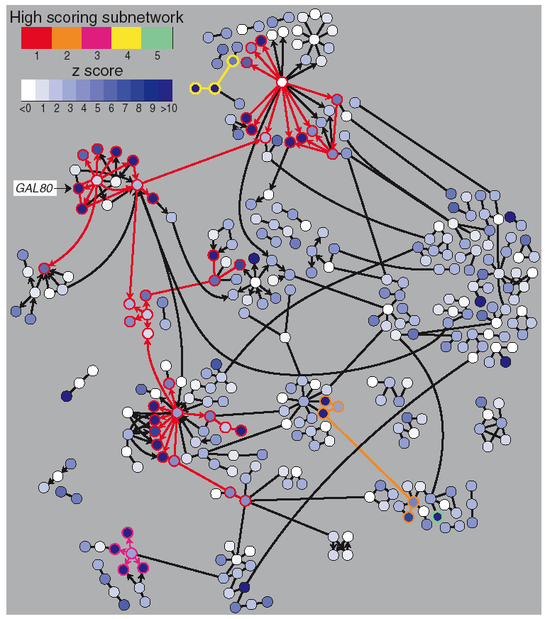
Why Networks?
Networks are…
  Commonly understood
  Structured to reduce complexity
  More efficient than tables
Network tools allow…
  Analysis
    Characterize network properties
    Identify hubs and subnets
    Classify, quantify and correlate, e.g.,
    cluster nodes by associated data
  Visualization
    Explore data overlays
    Interpret mechanisms, e.g., how a process
    is modulated or attenuated by a stimulus

Slide 10
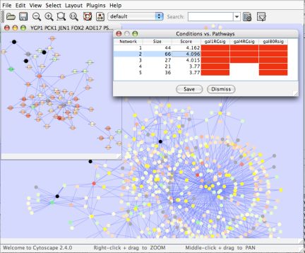
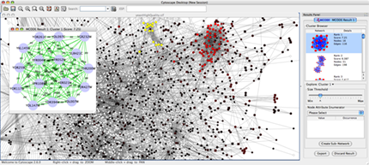
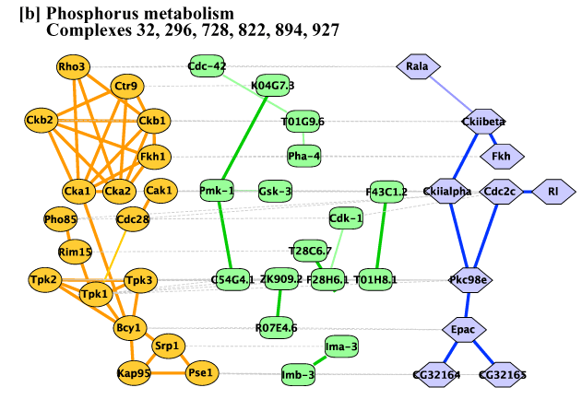
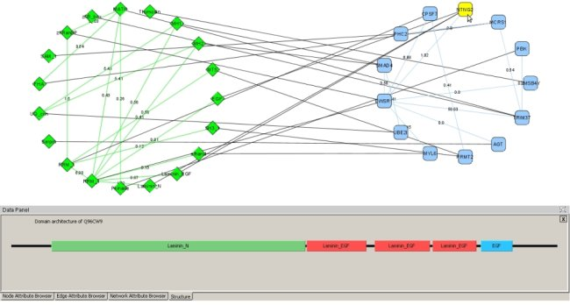
Applications of Network Biology
Gene Function Prediction shows connections to sets of genes/proteins involved in same biological process
Detection of protein complexes/subnetworks
discover modularity & higher order organization (motifs, feedback loops)
Network evolution
biological process(s) conservation across species
Prediction of interactions & functional associations
statistically significant domain-domain correlations in protein interaction network to predict protein-protein or genetic interaction
mCode, University of Toronto
jActiveModules, UCSD
PathBlast, UCSD
DomainGraph, Max Planck Institute
Notes:
Gene Function Prediction –
basic but important, examining genes (proteins) in a network context shows connections to sets of genes/proteins involved in same biological process that are likely to function in that process
Detection of protein complexes/other modular structures –
although interaction networks are based on pair-wise interactions, there is clear evidence for modularity & higher order organization (motifs, feedback loops)
Network evolution –
biological process(s) conservation across species (PathBLAST, NetworkBLAST to align p-p interaction networks & clusters)
Prediction of new interactions and functional associations –
Statistically significant domain-domain correlations in protein interaction network suggest that certain domain (and domain pairs) mediate protein binding. Machine learning extends this to suggest to predict protein-protein or genetic interaction through integration of diverse types of evidence for interaction

Slide 11
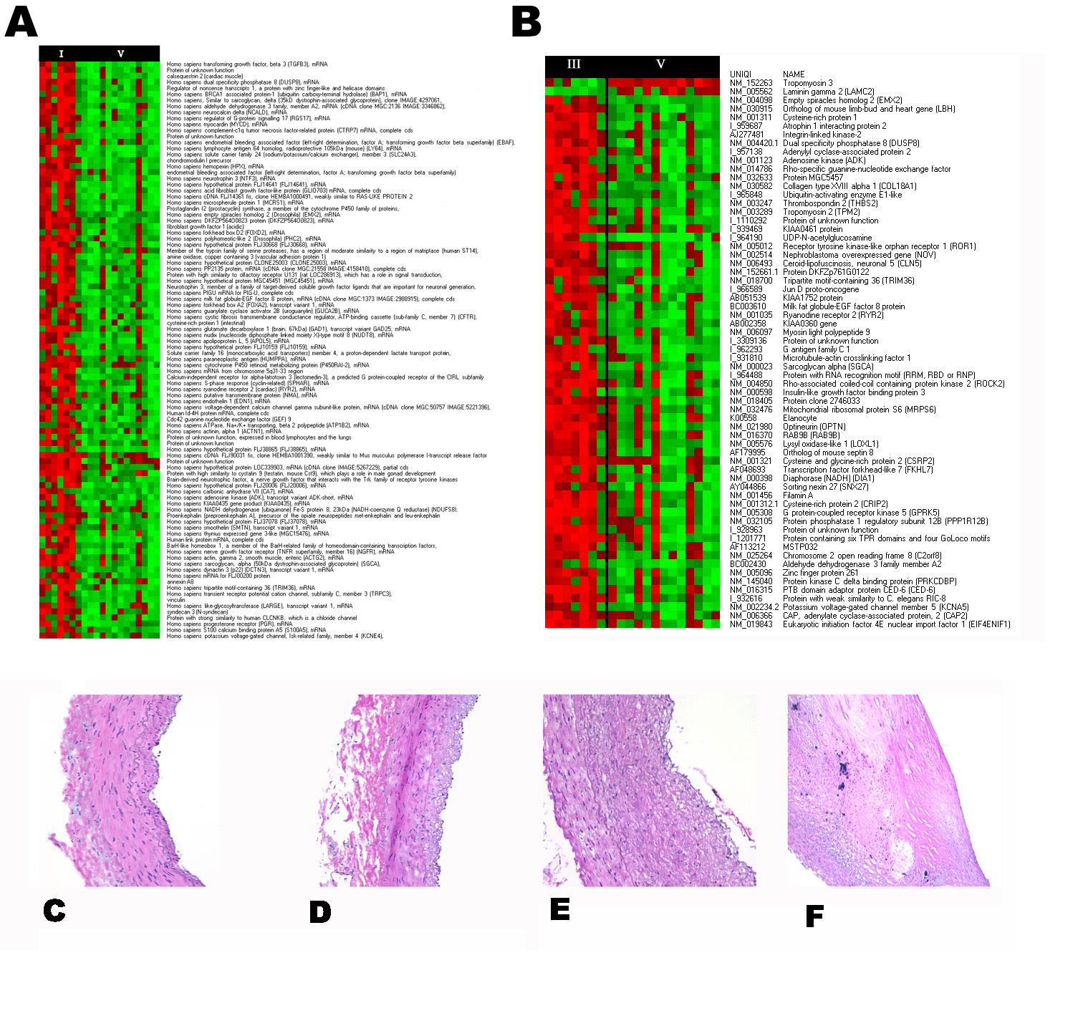
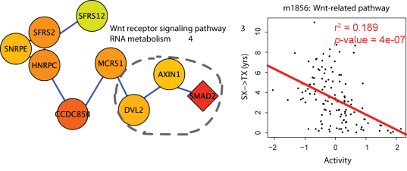
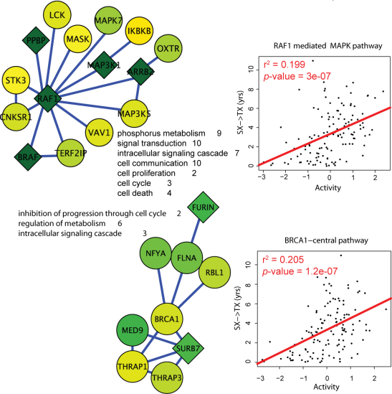
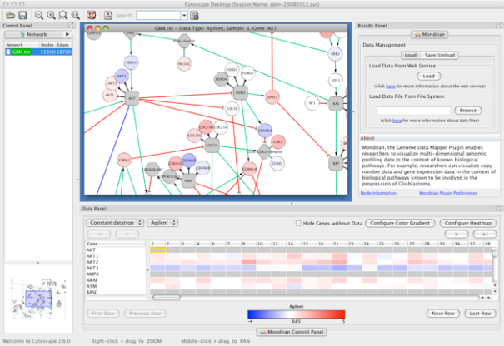
Applications in Disease
Identification of disease subnetworks – identification of disease network subnetworks that are transcriptionally active in disease.
Subnetwork-based diagnosis – source of biomarkers for disease classification, identify interconnected genes whose aggregate expression levels are predictive of disease state
Subnetwork-based gene association – map common pathway mechanisms affected by collection of genotypes (SNP, CNV)
Agilent Literature Search
PinnacleZ, UCSD
Mondrian, MSKCC
Notes:
Identification of disease subnetworks – identification of disease network subnetworks that are transcriptionally active in disease. These suggest key pathway components in disease progression and provide leads for further study and potential therapeutic targets
Subnetwork-based diagnosis – subnetworks also provide a rich source of biomarkers for disease classification, based on mRNA profiling integrated with protein networks to identify subnetwork biomarkers (interconnected genes whose aggregate expression levels are predictive of disease state)
Subnetwork-based gene association – molecular networks will provide a powerful framework for mapping common pathway mechanisms affected by collection of genotypes (SNP, CNV)

Slide 12
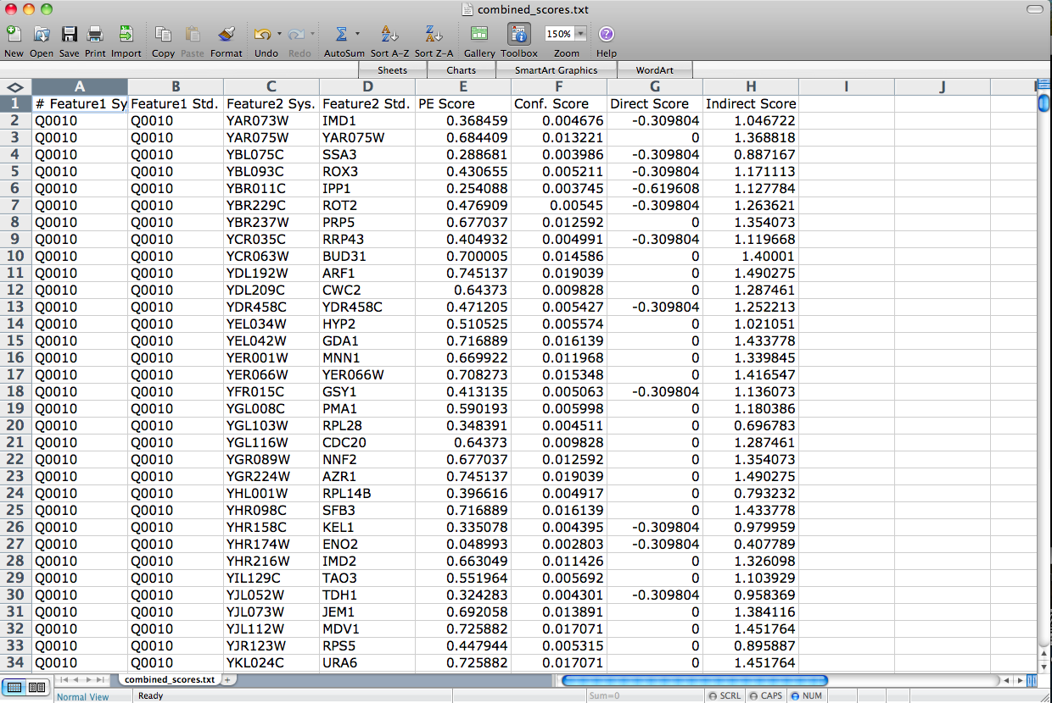
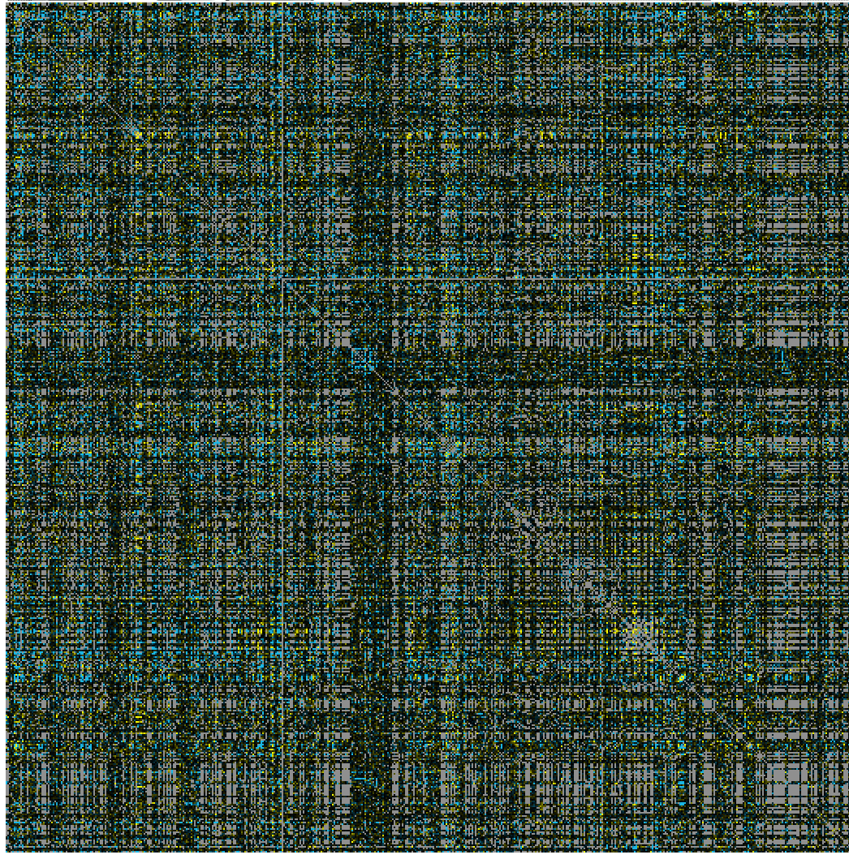
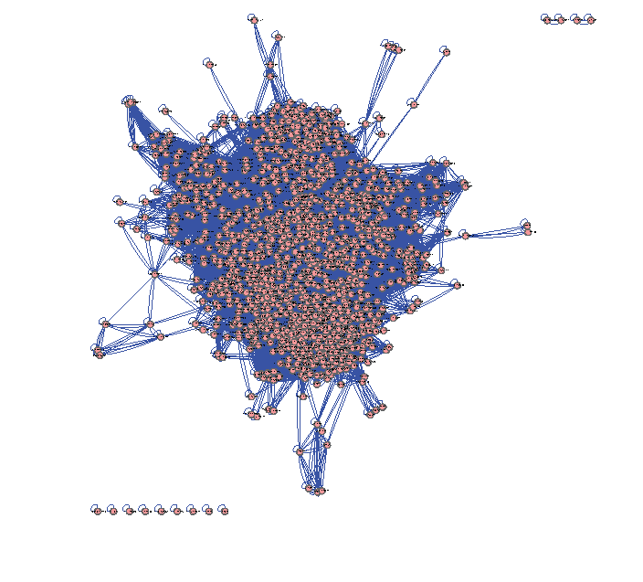
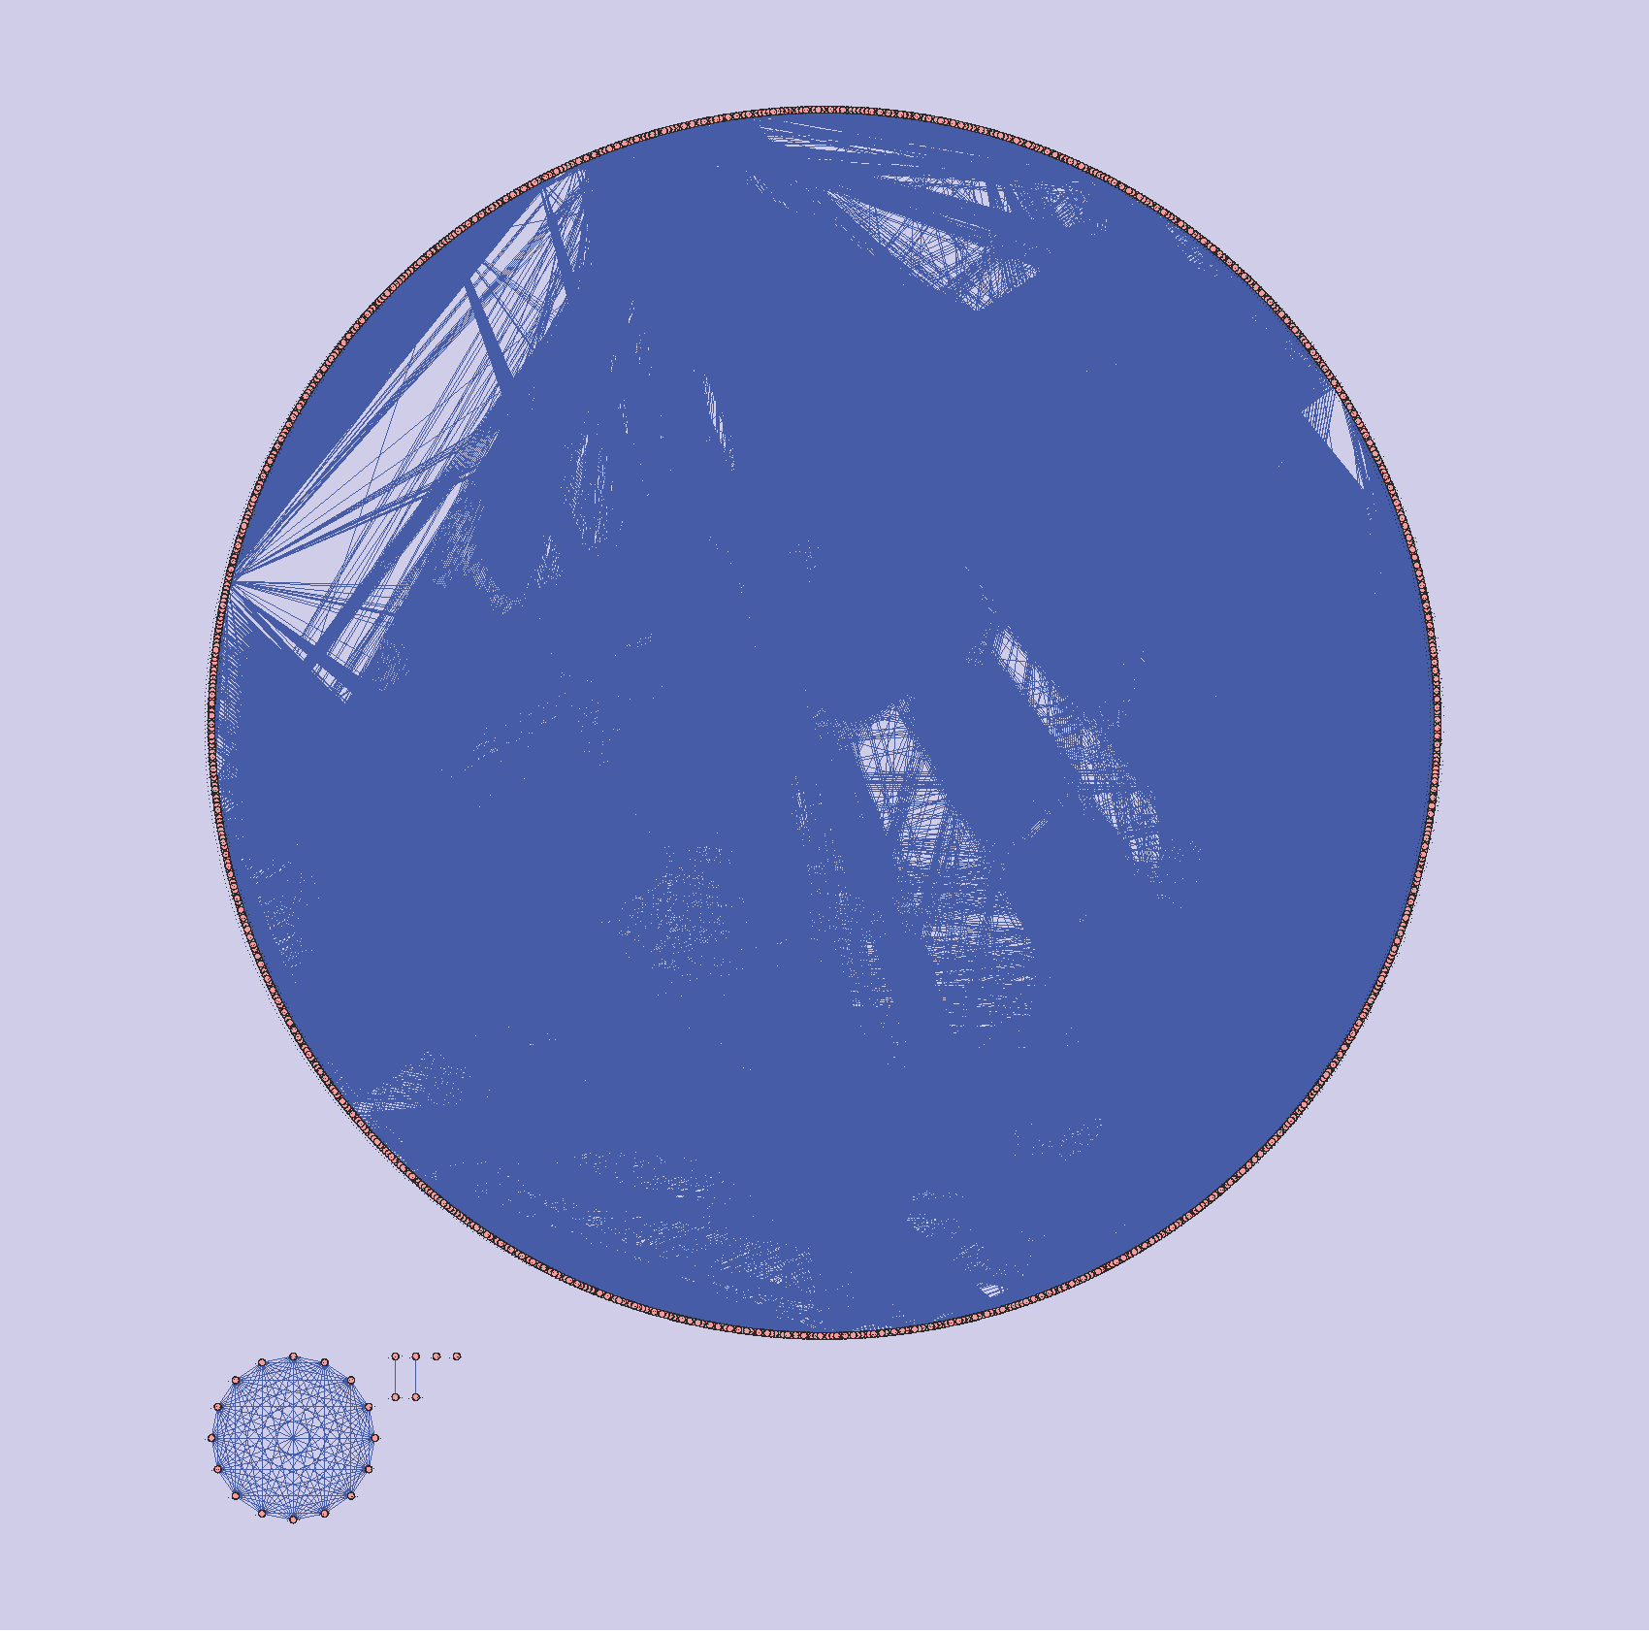
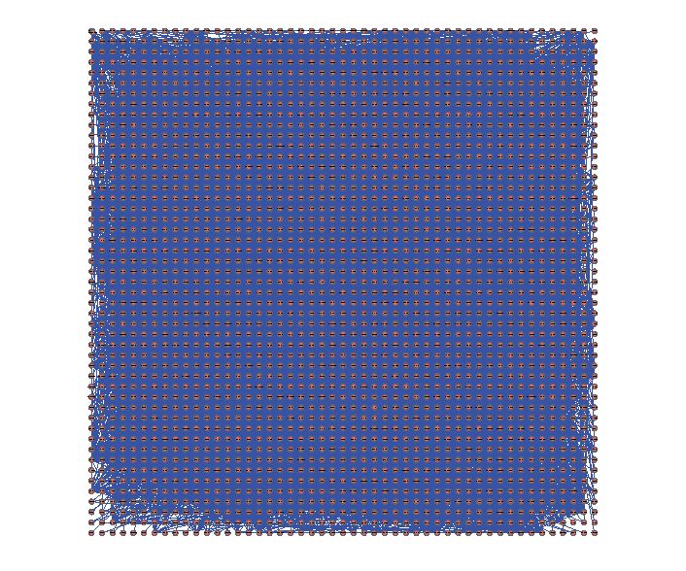
The Challenge
Making sense out of biological networks….

Slide 13
The Challenge
Biological networks
  Seldom tell us anything by themselves
  Analysis involves:
    Understanding the characteristics of the network
      Modularity
      Comparison with other networks (i.e., random networks)
  Visualization involves:
    Placing nodes in a meaningful way (layouts)
    Mapping biologically relevant data to the network
      Node size, node color, edge weights, etc
    …which then allowing for more analysis!

Slide 14
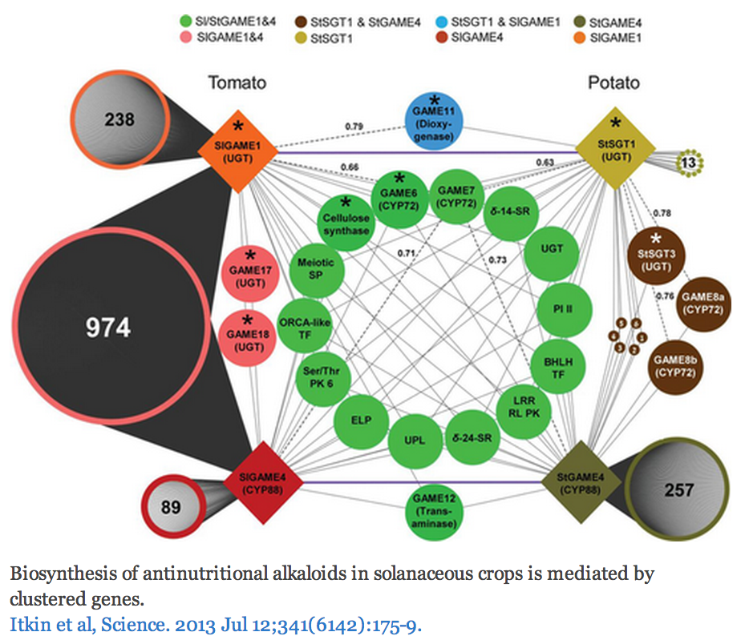
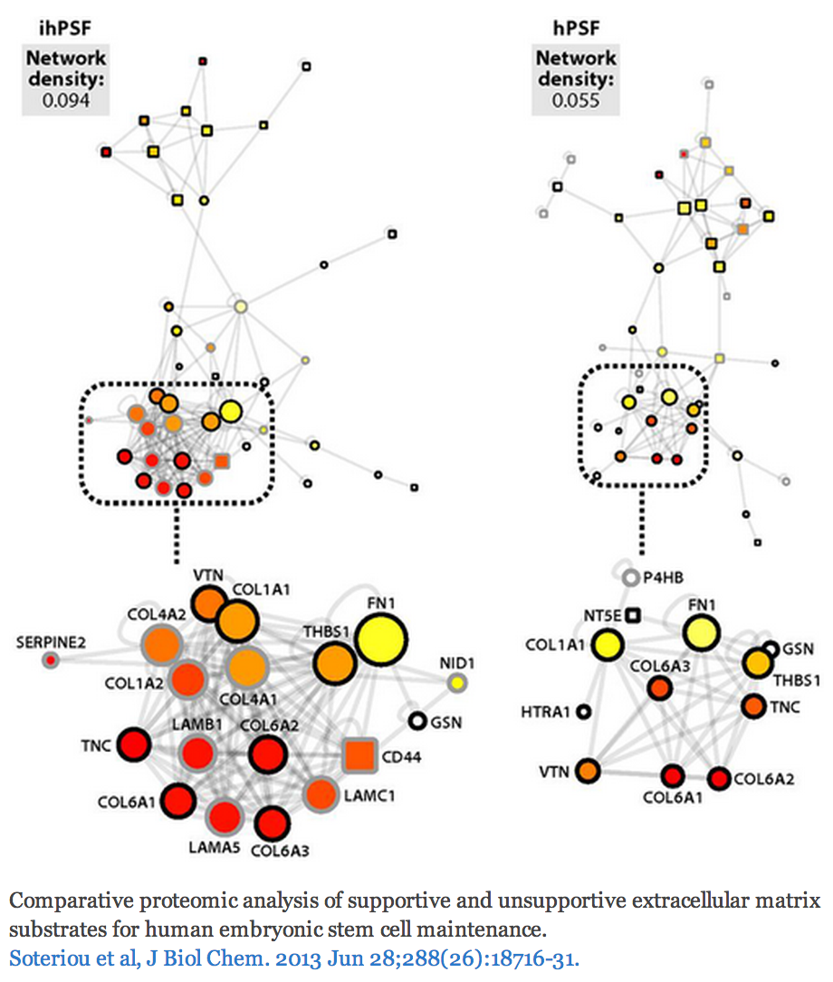
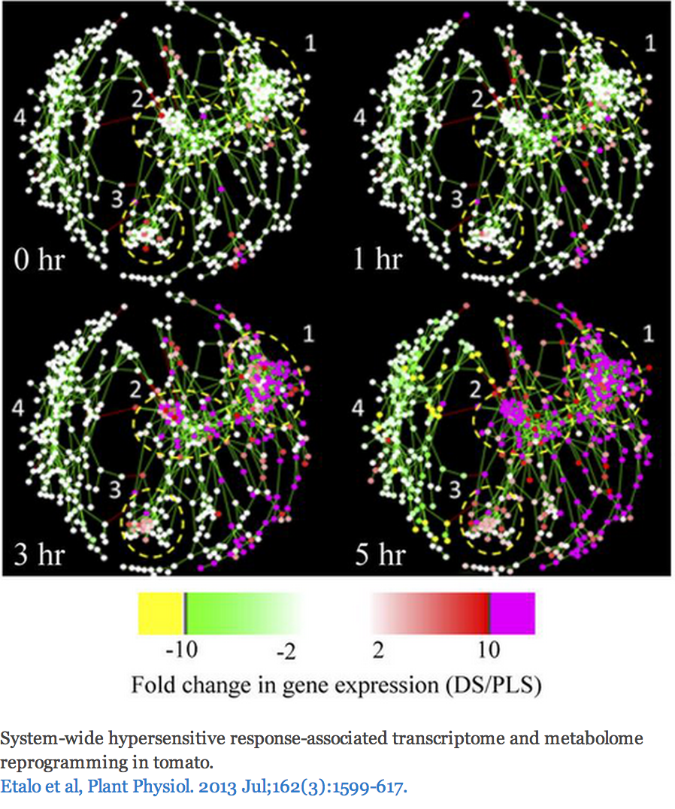
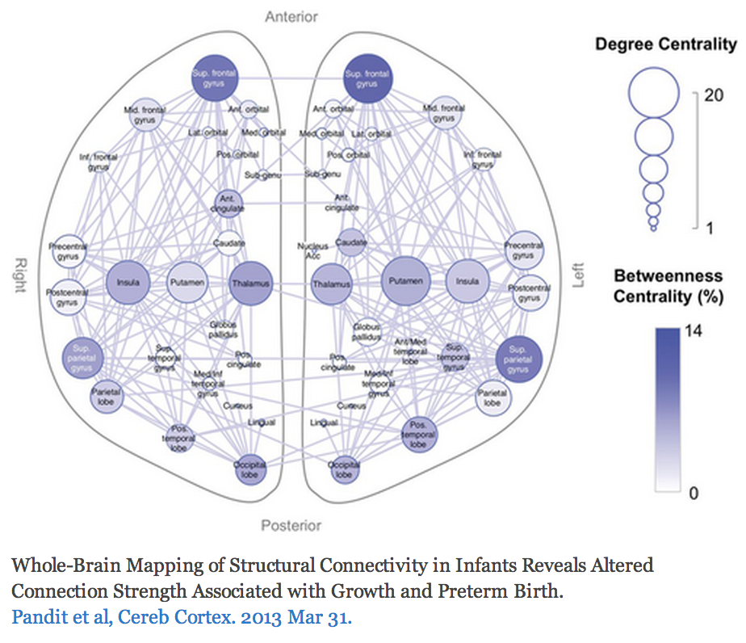
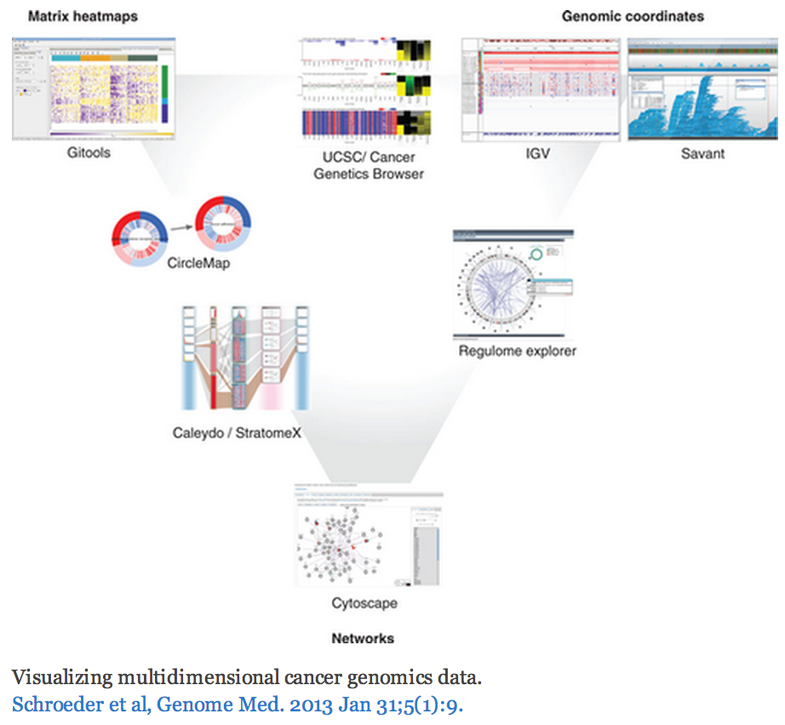
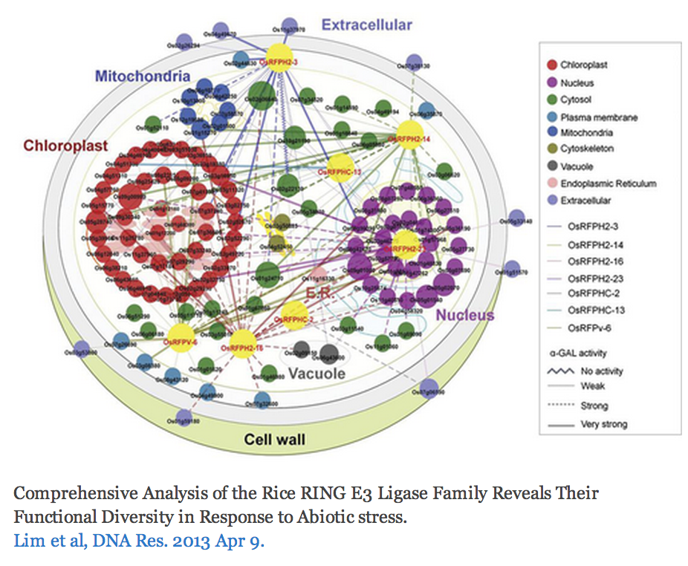
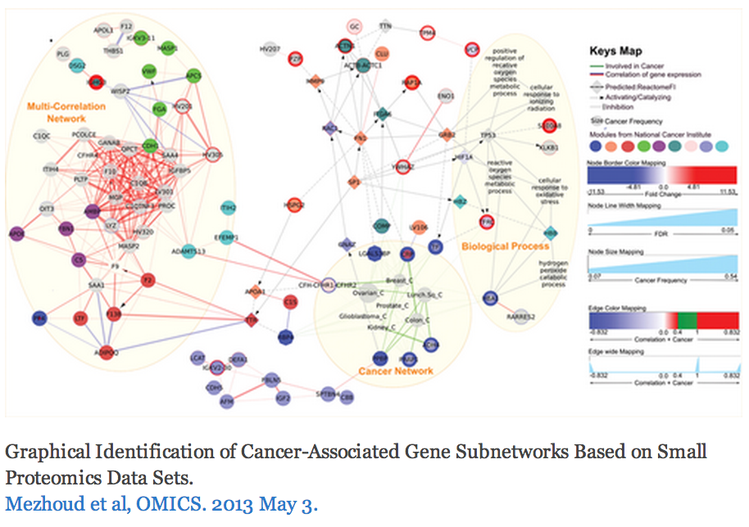
The Challenge
http://cytoscape-publications.tumblr.com/archive
Notes:
Some good examples
An example with perhaps too many visual properties
Cool cell illustration
Mapping brain regions (not proteins!)
Cytoscape is often just one part of an analysis pipeline

Slide 15
Biological Network Taxonomy
Pathways
  Signaling, Metabolic, Regulatory, etc
Notes:
Signaling pathway: Interleukin-2
Metabolic pathway: Krebs (TCA) Cycle

Slide 16
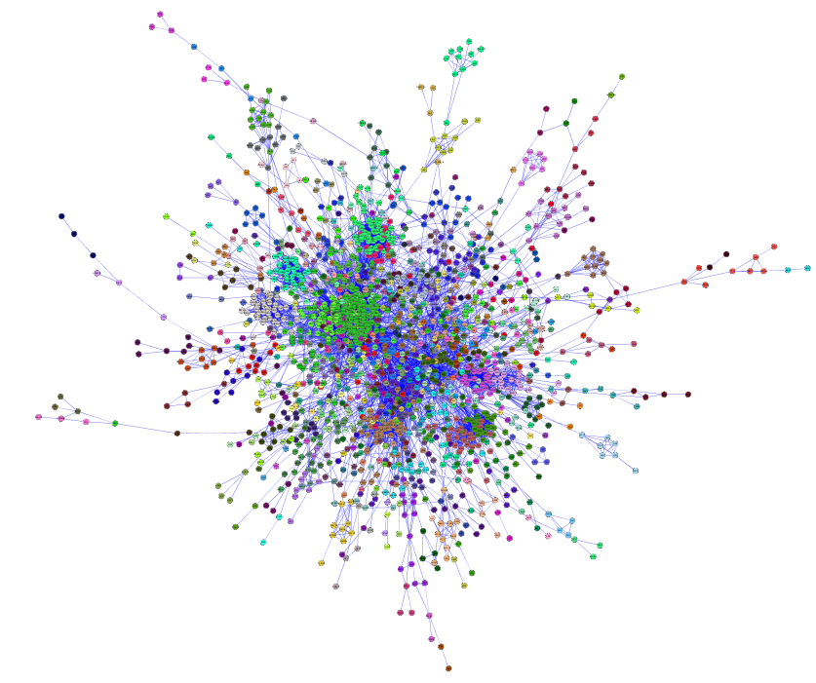
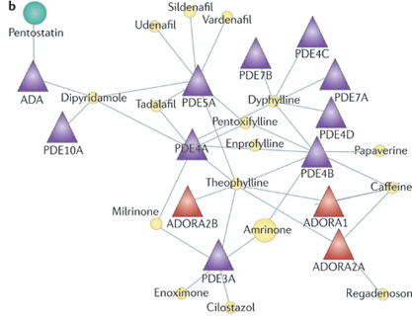
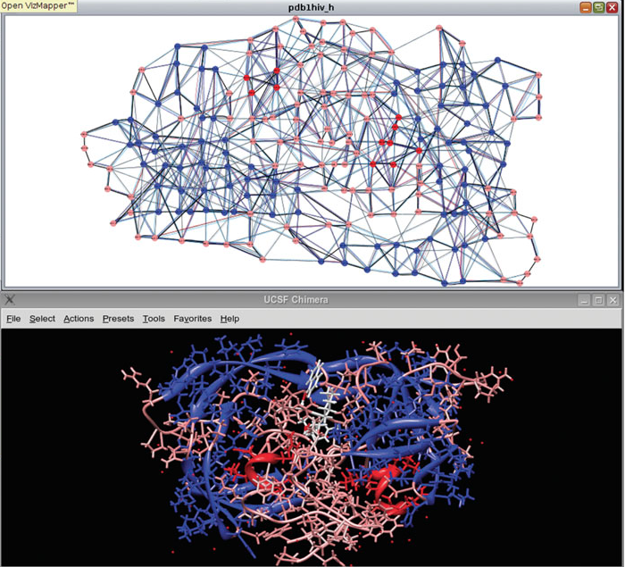
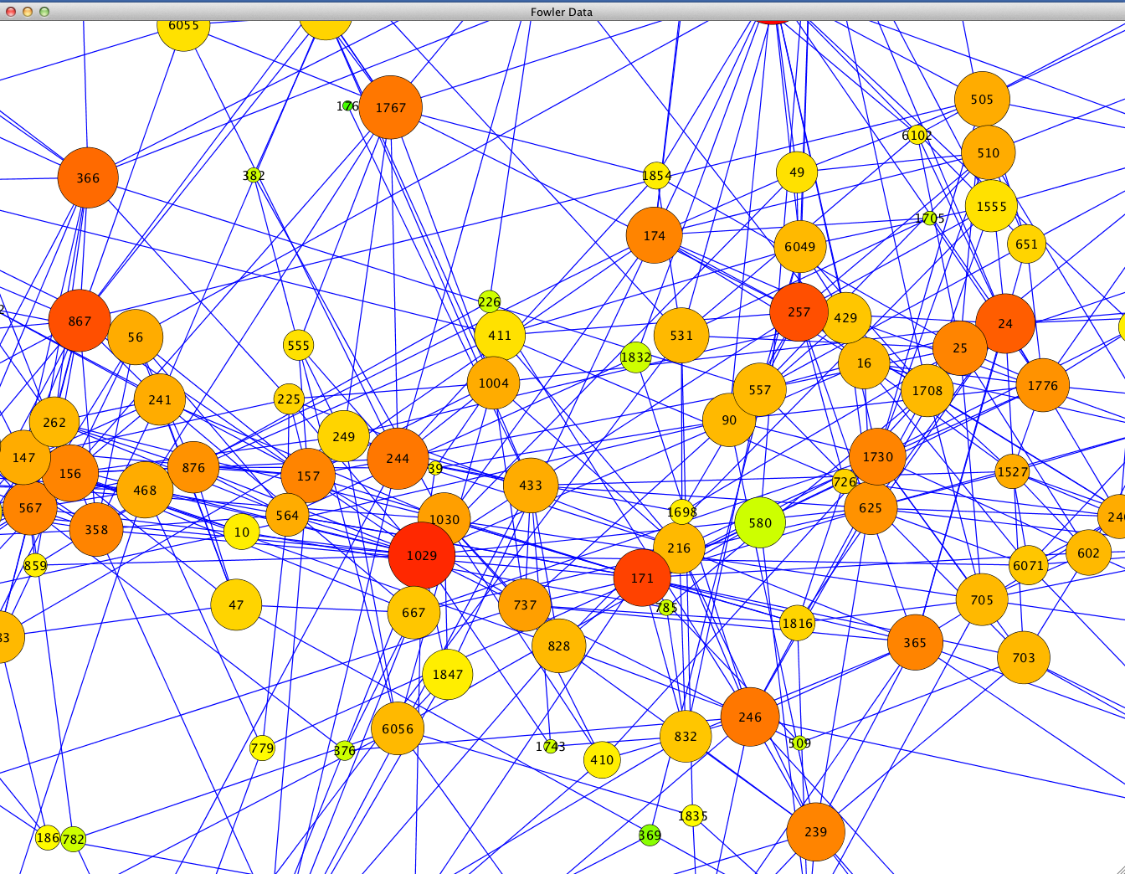
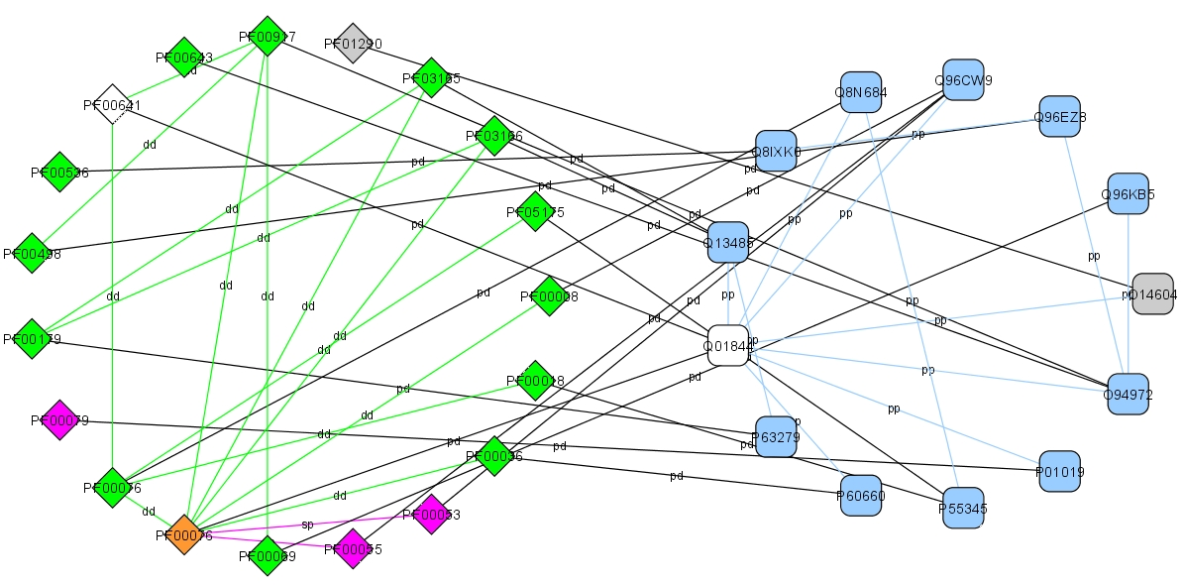
Biological Network Taxonomy
Interactions
  Protein-Protein
  Protein-Ligand
  Domain-Domain
  Others
    Residue or atomic
    Cell-cell
    Epidemiology
    Social networks

Slide 17
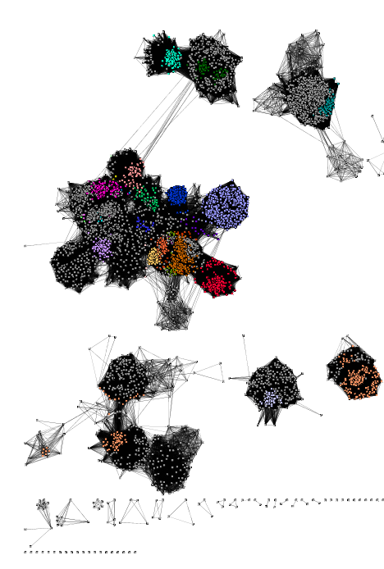
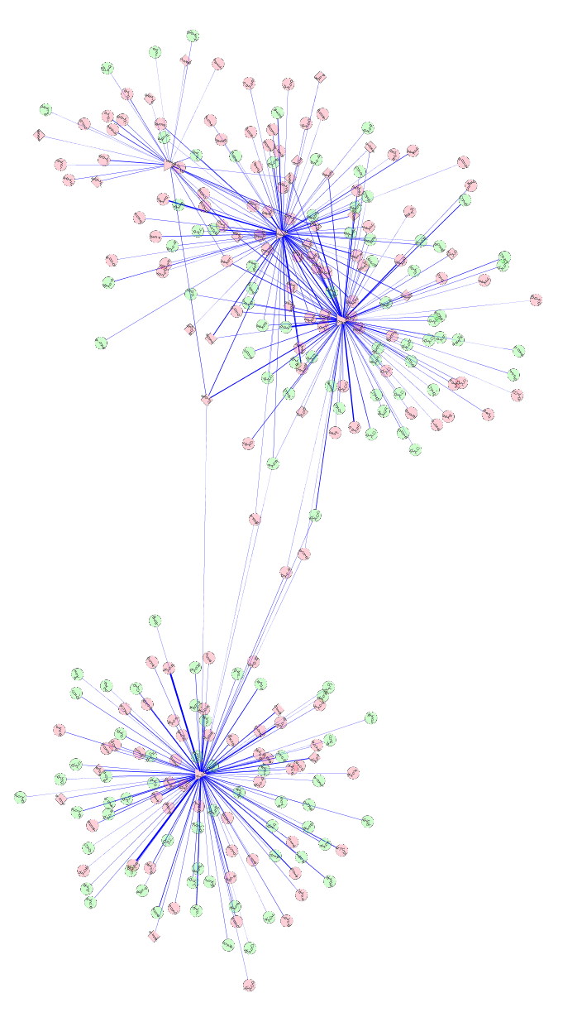
Biological Network Taxonomy
Similarity
  Protein-Protein
  Chemical similarity
  Ligand similarity (SEA)
  Others
    Tag clouds
    Topic maps

Slide 18
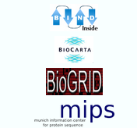
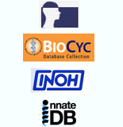
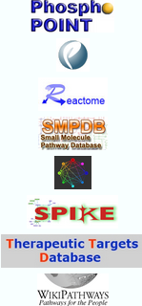
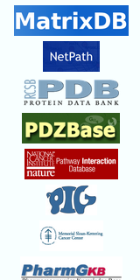
Biological Network Taxonomy
Where do I get the network?
There is no such thing!
550 different interaction databases!
… in 2013
It depends on your biological question
and your analysis plan.

Slide 19

Biological Network Taxonomy
Where do I get the network?
There is no such thing!
… in 2016
http://ndexbio.org

Slide 20
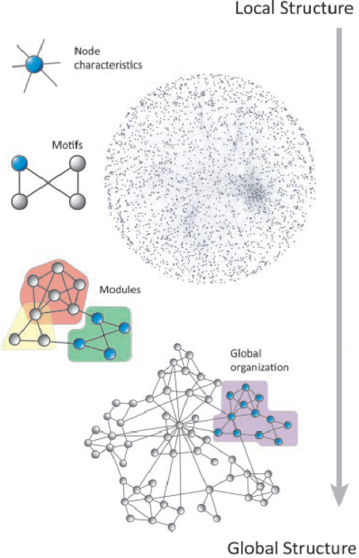
Analytical Approaches
The levels of organization of complex networks:
Node degree provides information about single nodes
Three or more nodes represent a motif
Larger groups of nodes are called modules or communities
Hierarchy describes how the various structural elements are combined

Slide 21
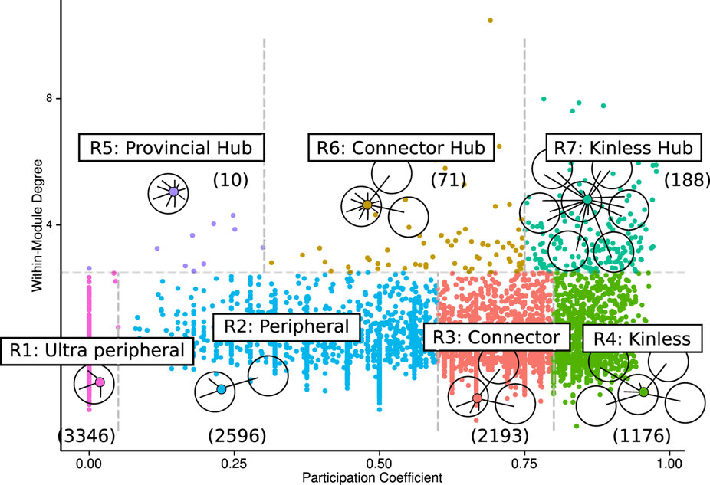
Analytical Approaches
Piñero, Sci Rep, 15 April 2016
Notes:
“Cancer genes are central not only in terms of number of neighbors, but also in terms of the clusters they connect. Remarkably, we found that high Participation roles played by cancer genes are not explained by their higher number of interactions, but by their unique inter-modular connectivity patterns. We also found that these connectivity patterns differ for disease genes with contrasting inheritance modes: while autosomal dominant genes play high participation roles, autosomal recessive genes are more confined to their own modules. “
Replicates over 6 different interaction networks (HIPPIE¹⁸, BIANA⁴⁰, BioGRID⁴¹, IntAct⁴², IrefIndex⁴³ and from Human Interactome Project (HBI)^{19,44}). Looked at ~2000 Mendelian disease genes and 781 “cancer driver genes.”

Slide 22
Analytical Approaches
Network topology statistics such as node degree, degree distribution, centralitiy, clustering coefficient, shortest paths, and robustness of the network to the random removal of single nodes are important network characteristics.
Motif analysis is the identification of small network patterns that are over-represented when compared with a randomized version of the same network. Regulatory elements are often composed of such motifs.
Modularity refers to the identification of sub-networks of interconnected nodes that might represent molecules physically or functionally linked that work coordinately to achieve a specific function.
Network alignment and comparison tools can identify similarities between networks and have been used to study evolutionary relationships between protein networks of organisms.

Slide 23
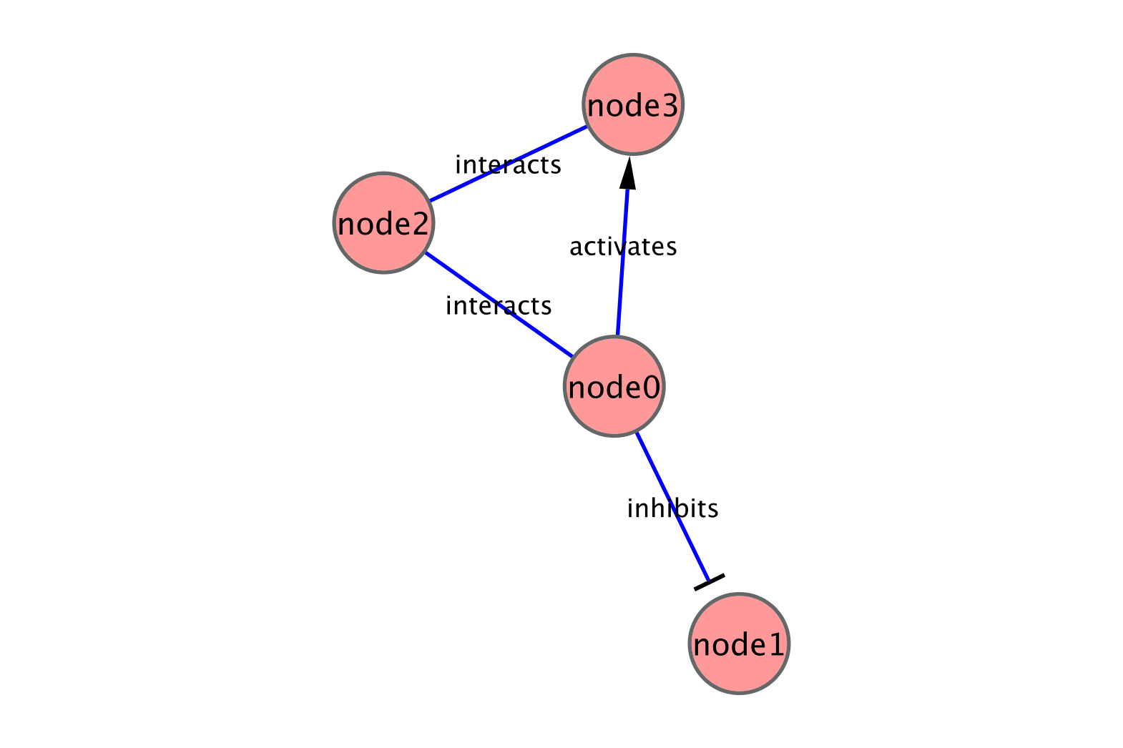
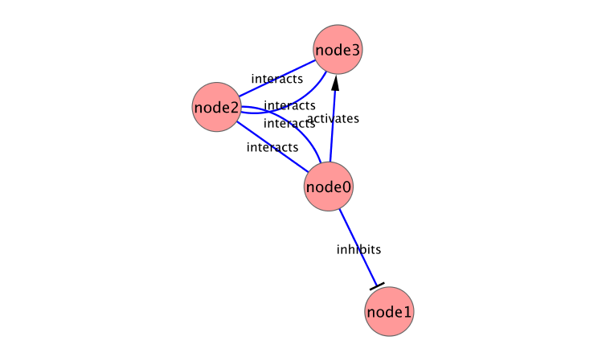
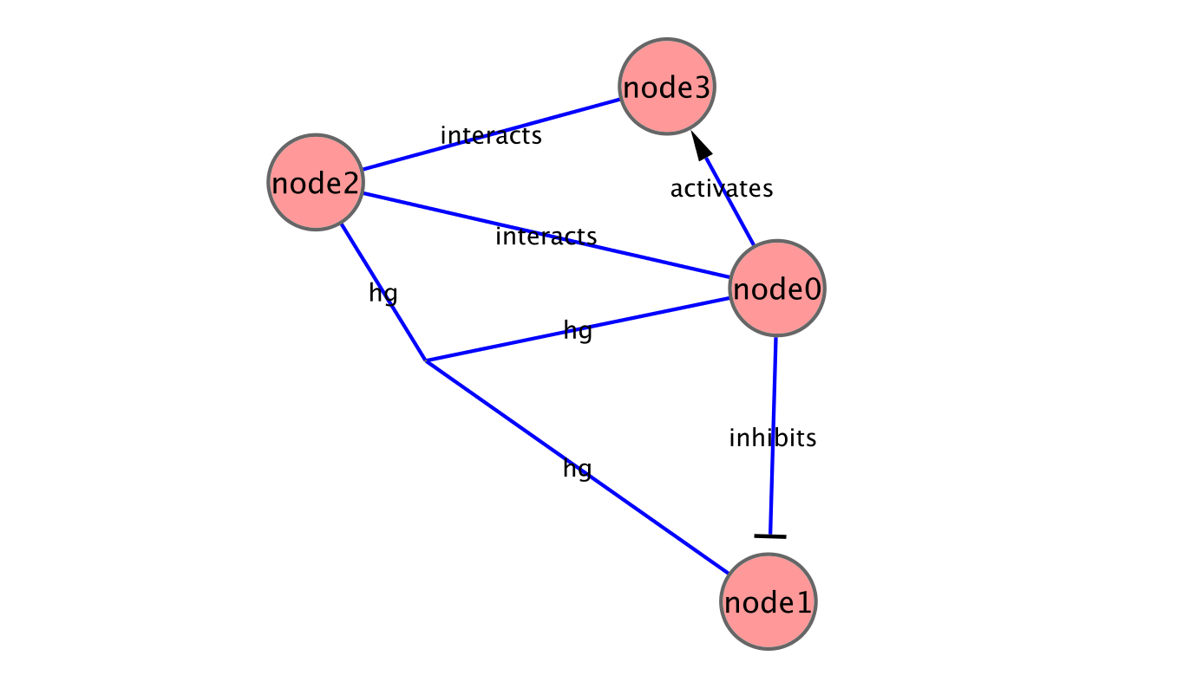
Analytical Approaches
Concepts
  Graph/Network correspondence
  Node/Vertex correspondence
  Edge directedness
    Usually a network property
  Multigraph
    Allow multiple edges between nodes
  Hypergraph
    Allow edges to connect more than 2 nodes

Slide 24
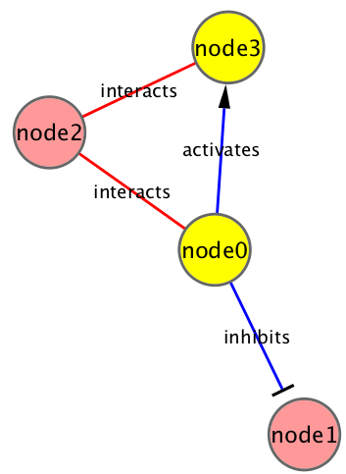
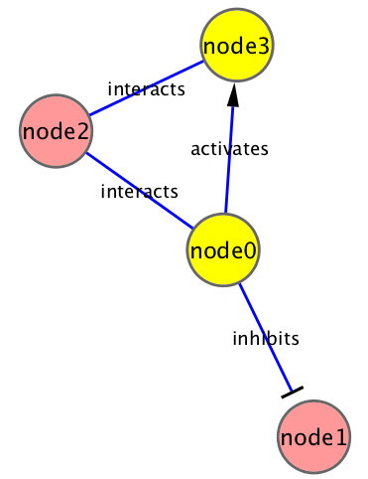
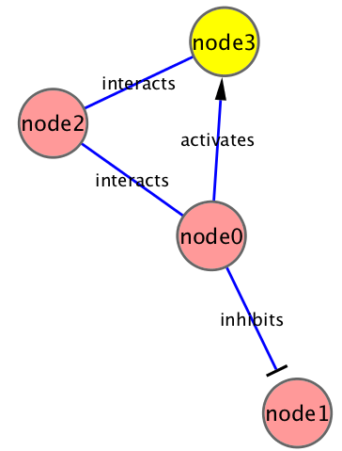

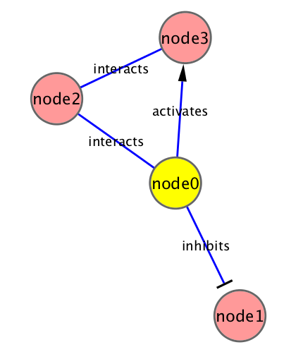
Analytical Approaches
Network measures
  Node degree
    Indegree: # of edges for which this node is a target
    Outdegree: # of edges for which this node is a source
  Hub
    node with an exceptionally high degree
  Shortest path length
    Shortest traversal distance between two nodes
    Can be weighted if edges have weights or hops if not
Notes:
Network measures
Node degree
Indegree: # of edges for which this node is a target
Outdegree: # of edges for which this node is a source
Hub
node with an exceptionally high degree
Shortest path length
Shortest traversal distance between two nodes
Can be weighted if edges have weights or hops if not

Slide 25
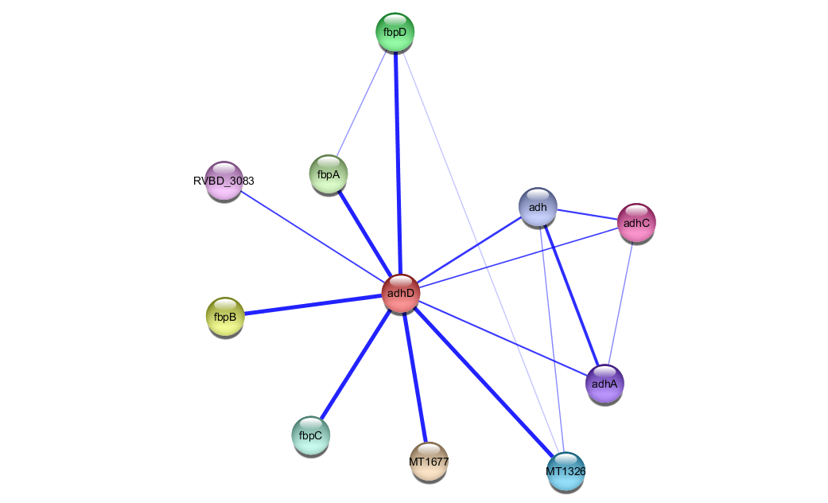
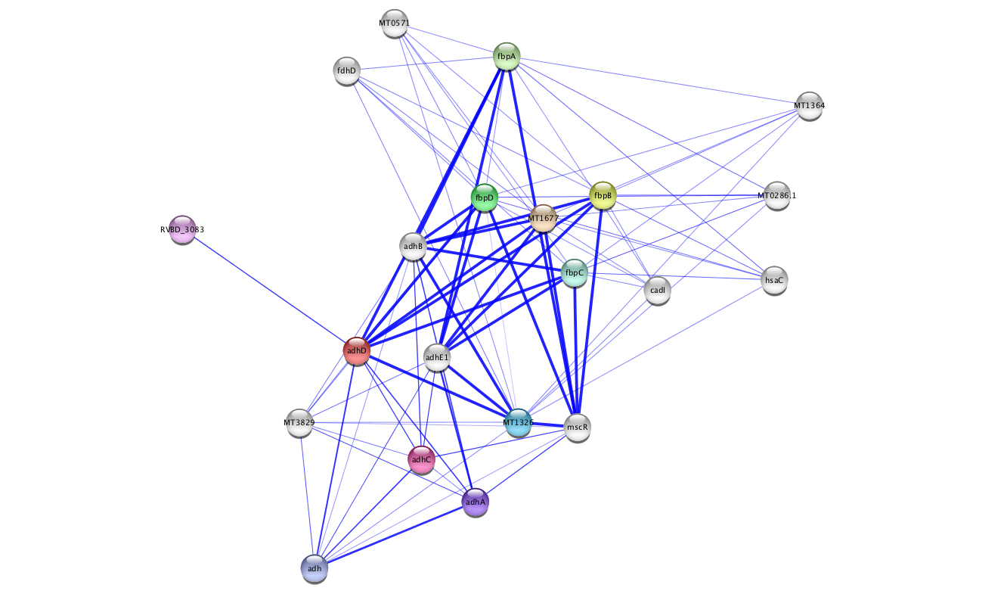
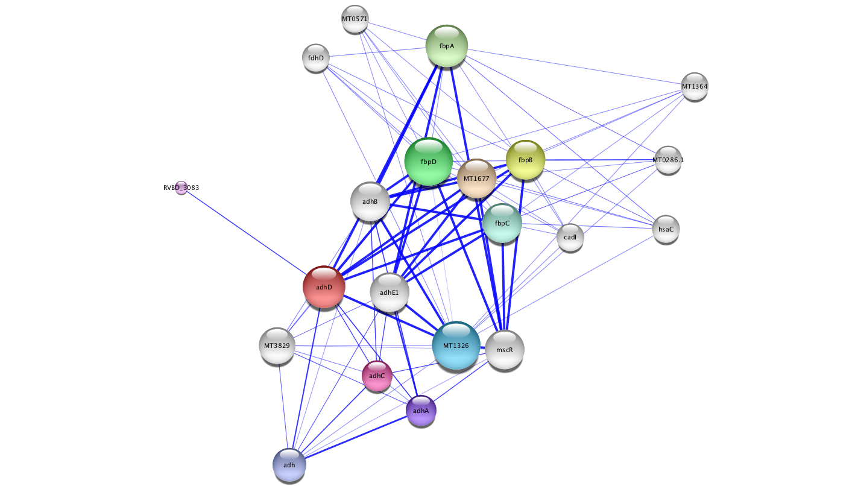
Analytical Approaches
Network measures
  Node degree
    Indegree: # of edges for which this node is a target
    Outdegree: # of edges for which this node is a source
    Degree (undirected): # of edges incident to this node
  Hub
    node with an exceptionally high degree
3
4
3
10
3
3
Notes:
Network measures
Node degree
Indegree: # of edges for which this node is a target
Outdegree: # of edges for which this node is a source
Hub
node with an exceptionally high degree
Shortest path length
Shortest traversal distance between two nodes
Can be weighted if edges have weights or hops if not

Slide 26
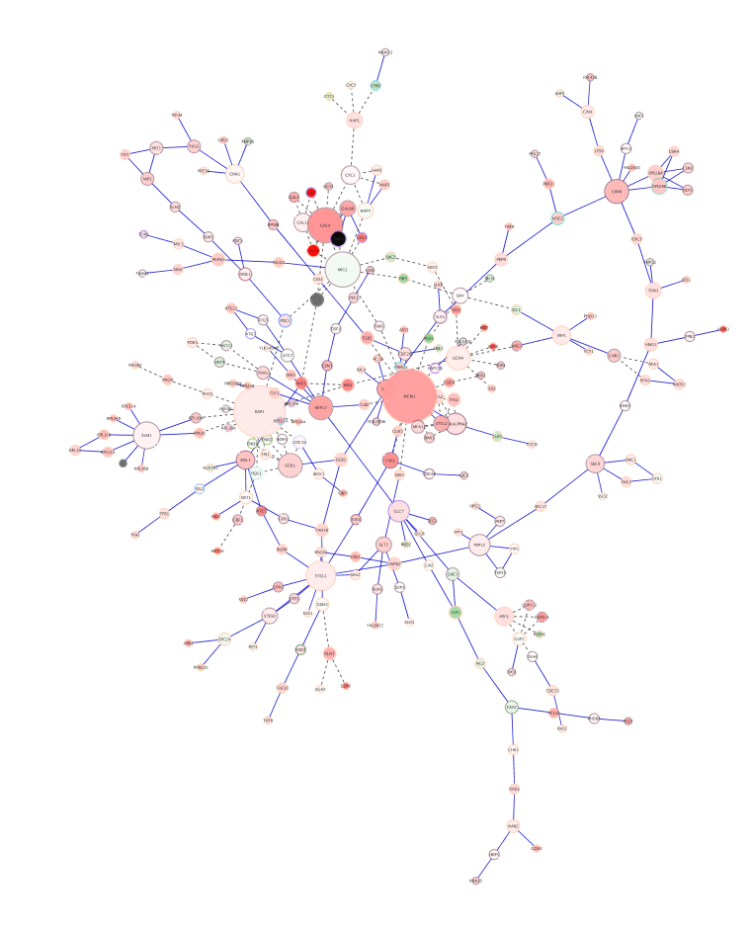
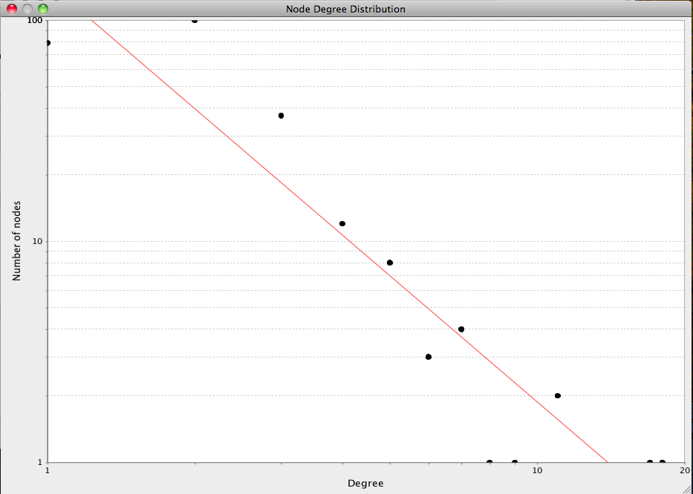
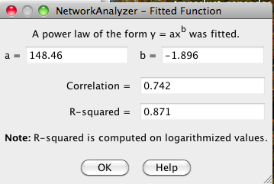
Analytical Approaches
Scale-free networks
  Degree distribution follows power law:
    P(k) ~ k^{-γ}, where γ is a constant.
  Result is that there are distinctive “hubs” (essential proteins?)
  Overall, though, network is resilient to perturbation
  Biological (and social) networks tend to be scale-free

Slide 27
Analytical Approaches
Network measures
  Shortest path length
    Shortest traversal distance between two nodes
    Can be weighted if edges have weights or hops if not
2
1

Slide 28
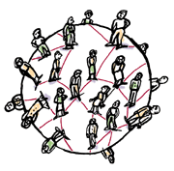
Analytical Approaches
Small-world networks
  any two arbitrary nodes are connected by a small number of intermediate edges
  the network has an average shortest path length much smaller than the number of nodes in the network (Watts, Nature, 1998).
  Interaction networks have been shown to be small-world networks (Barabási, Nature Reviews in Genetics, 2004)

Slide 29
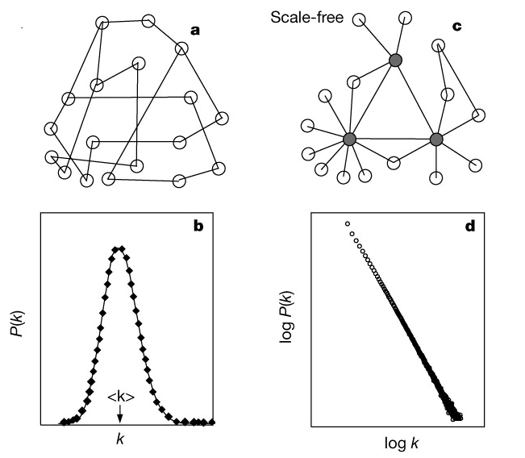
Analytical Approaches
Random networks
  Algorithms exist to create random networks
    Flat random network: Erdos-Renyi (homogeneous, nodes have similar degrees, and not robust to arbitrary node failure)
    Scale-free: Barabasi-Albert
    Small-world (high clustering): Watts-Strogatz
  Useful to compare your network vs. a random network

Slide 30
Analytical Approaches
Network measures
  Clustering coefficient
    Measures how close the neighbors of a node are to being a clique (fully connected group)
    # of edges connecting a node’s neighbors/the node’s degree
1.0
0.5
0.3
0

Slide 31
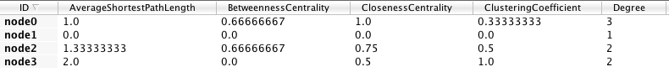
Analytical Approaches
Centrality - measures of node importance
  Degree centrality (find hubs)
    Degree of this node / (# of nodes – 1)
  Betweenness centrality (bottleneck)
    The average number of shortest paths that go through this node / (# of pairs)
  Closeness centrality
    The sum of all shortest paths between this node and all other nodes / (# of nodes – 1)

Slide 32
Analytical Approaches
Network Analyzer Demo…

Slide 33
Analytical Approaches
Guilt by association
  Combine weak signals to get a stronger one.
  Two main applications:
    Suggest network or functional relationship based on related data (e.g. co-expression).
    Infer function or role (i.e. in disease) based on related data
  Some algorithmic approaches
    Random walk with restarts
    Semi-supervised learning
    Belief Propagation
  Example: GeneMANIA

Slide 34
Analytical Approaches
GeneMANIA Demo…

Slide 35


Analytical Approaches
Motif finding
  Search directed networks for network motifs (feed-forward loops, feedback loops, etc.)

Slide 36




Analytical Approaches
Finding subnetworks of similarly expressed genes
Finding the shortest path between nodes

Slide 37





Analytical Approaches
Overrepresentation analysis
  Find terms (GO) that are statistically overrepresented in a network
  Not really a network analysis technique
  Very useful for visualization
Notes:
Note: all Cytoscape ORA tools provide a network visualization of terms and a ranked table with statistics

Slide 38






Analytical Approaches
Clustering (find hubs, complexes)
  Goal: group related items together
Clustering types:
  Hierarchical clustering
    Divide network into pair-wise hierarchy
  K-Means clustering
    Divide network into k groups
  MCL
    Uses a flow simulation to find groups
  Community Clustering
    Maximize intra-cluster edges vs. inter-cluster edges

Slide 39
Visualization of Biological Networks
Data Mapping
Layouts
Animation

Slide 40





Depiction
Various ways to depict biological networks:
  Node-Link (graph) representation
  Partitioned Node-Link representation
  Matrix representation
    Can be useful for very dense networks
    Can also map information into cells of matrix
      e.g. degree, color scale (heat map)
  Hierarchical reduction to 1D
  Orthogonal 1D representation of nodes/edges
Notes:
Last two:
- NetGestalt (used to align data in fashion of genome browsers)
- BioFrabric (used to organize/explore massive hairballs)

Slide 41








Data Mapping
Mapping of data values associated with graph elements onto graph visuals
Visual attributes
  Node fill color, border color, border width, size, shape, opacity, label
  Edge type, color, width, ending type, ending size, ending color
Mapping types
  Passthrough (labels)
  Continuous (numeric values)
  Discrete (categories)

Slide 42
Data Mapping
Avoid cluttering your visualization with too much data
  Highlight meaningful differences
  Avoid confusing the viewer
  Consider creating multiple network images

Slide 43






Layouts
Layouts determine the location of nodes and (sometimes) the paths of edges
Types:
  Simple
    Grid
    Partitions
  Hierarchical
    layout data as a tree or hierarchy
    Works best when there are no loops
  Circular (Radial)
    arrange nodes around a circle
    could use node attributes to govern position
      e.g. degree sorted

Slide 44


Layouts
Types:
  Force-Directed
    simulate edges as springs
    may be weighted or unweighted
  Combining layouts
    Use a general layout (force directed) for the entire graph, but use hierarchical or radial to focus on a particular portion
  Multi-layer layouts
    Partition graph, layout each partition then layout partitions
  Many, many others

Slide 45
Layouts
Use layouts to convey the relationships between the nodes.
Layout algorithms may need to be “tuned” to fit your network.
There is not one correct layout. Try different things.

Slide 46

Animation
Animation is useful to show changes in a network:
  Over a time series
  Over different conditions
  Between species
Notes:
http://git.dhimmel.com/SIDER2/similarity/

Slide 47
Introduction to Cytoscape
Overview
Core Concepts
  Networks and Tables
  Visual Properties
  Cytoscape Apps
Working with Data
  Loading networks from files and online databases
  Loading data tables from CSV or Excel files
  The Table Panel
Notes:
EDIT: according to schedule

Slide 48





Cytoscape
  Open source
  Cross platform
  Consortium
University of Toronto
Notes:
NOTE: Pre-acknowledgements slide

Slide 49


Core Concepts
Networks and Tables
Networks
e.g., PPIs or pathways
Tables
e.g., data or annotations
Notes:
Notes: it is a Cytoscape goal that both the graph model and the data are free from Biological semantics

Slide 50

Core Concepts
Networks and Tables
Networks
Tables
Visual Styles

Slide 51



Core Concepts
Cytoscape Apps!
apps.cytoscape.org
Notes:
Screenshots: App Store front page, example app, and wall of apps
Note: mention increasing number of apps (and ports to 3.x)
Alternative: visit App Store live
272 apps – April 2016
51

Slide 52



Loading Networks
Use import network from file
  Excel file
  Comma or tab delimited text

Slide 53



Loading Networks
But what if I don’t have a network?!
Notes:
Welcome!
- web services: a couple provided by default (more in App Store)
- preset networks from BioGRID per species (mouse over for details)

Slide 54

Loading Tables
Nodes and edges can have data associated with them
  Gene expression data
  Mass spectrometry data
  Protein structure information
  Gene Ontology terms, etc.
Cytoscape supports multiple data types: Numbers, Text, Boolean, Lists...

Slide 55



Loading Tables
Use import table from file
  Excel file
  Comma or tab delimited text

Slide 56




Visual Style Manager
Click on the Styles tab
Notes:
New interface!
- def, map, byp
- example continuous mapping panel
- menu of provided visual styles

Slide 57


Selection Filters
Click on Select tab

Slide 58
Saving and Exporting
Sessions save everything as .cys files: Networks, Tables, Styles, Screen sizes, etc
Export networks in different formats:
SIF, GML, XGMML, BioPAX, PSI-MI 1 & 2.5
Publication quality graphics in several formats: PDF, EPS, SVG, PNG, JPEG, and BMP

Slide 59

Getting Help

Slide 60
Tips & Tricks
Network Collections
  Each collection has a “root” network
  Changing the attribute for a node in one network will also change that attribute for a node with the same SUID in all other networks within the collection
  You can clone a network into a new collection to “decouple” it and start a new root

Slide 61
Tips & Tricks
Network views
  When you open a large network, you will not get a view by default
  To improve interactive performance, Cytoscape has the concept of “Levels of Detail”
    Some visual attributes will only be apparent when you zoom in
    The level of detail for various attributes can be changed in the preferences
    To see what things will look like at full detail:
      View→Show Graphics Details

Slide 62
Tips & Tricks
Sessions
  Sessions save pretty much everything:
    Networks
    Properties
    Visual styles
    Screen sizes
  Saving a session on a large screen may require some resizing when opened on your laptop

Slide 63
Tips & Tricks
Task monitor
  Current task displayed in status bar (lower left)
  Icon opens complete task history
Memory
  Current status (lower right)
  Toggle open for details and “Free Unused Memory” button
Notes:
Note: these used to be major issues in 2.x

Slide 64
Tips & Tricks
CytoscapeConfiguration directory
  Your defaults and any apps downloaded from the App Store will go here
App Manager
  This is where you search/install/update/uninstall apps
  You now have the option of disabling vs. uninstalling…
  Can also install and update apps directly from the App Store website, if you have Cytoscape 3 up and running

Slide 65
Cytoscape: Platform
Cytoscape as a platform
  App architecture
    http://apps.cytoscape.org
  Use cases
    Expression data analysis
    Protein complexes
    Agilent literature search

Slide 66
Hands-on Tutorial
Introduction to Cytoscape:
Networks, Data, Styles, Layouts and App Manager
tutorials.cytoscape.org

Slide 67
Hands-on Tutorial
App Tutorials:
http://tutorials.cytoscape.org
http://rbvi.ucsf.edu/cytoscape/structureViz2/tutorial.html
http://rinalyzer.de/tutorials.php
Notes:
TODO: Update

Slide 68
Examples/Demos
clusterMaker
  Clustering and cluster visualizations
Agilent LitSearch Tool
  Extracting networks from abstracts
WikiPathways
  Search and load pathway diagrams
Notes:
clusterMaker:
- simple: galFiltered -> BiNGO
- complex: collins PPI
litSearch:
- CDC25, human, cancer
WikiPathways
- human: TCA, Statin or 5-FU

Slide 69


Expression Data Analysis
Load galFiltered.cys
Explore the expression fold changes: gal1RGexp, gal4RGexp, and gal80Rexp. The network is colored by gal4RGexp values.
To explore the expression profile for these three deletions, we can use clusterMaker to do a hierarchical cluster
  Apps→clusterMaker→Hierarchical
  Choose the attributes we’re interested in (node.gal1RGexp, node.gal4RGexp, node.gal80Rexp)
  Choose the type of clustering (pairwise average-linkage, Euclidean distance)
  Click “Show TreeView when complete”
  Click OK
Notes:
The example file, galFiltered.cys is included with all Cytoscape releases. It is taken from Ideker, et.al. 2001, although it has gained significantly more annotations over the years. It shows a protein-protein interaction network that focuses on the galactose (gal) utilization in the yeast Saccharomyces cerevisiae. The network was perturbed by gene deletion of the major GAL genes, then the cells were grown in the presence and absence of galactose.

Slide 70


Expression Data Analysis
  After the clustering is complete (very fast) the Tree View will be shown
    If the colors are too dark, they can be adjusted in the Settings… dialog.
  Select the dendrogram branch at the top, as shown
    Note that this will also select those proteins in the network view

Slide 71


Expression Data Analysis
Now we can see if these genes show any GO overrepresentation
Start BiNGO
  Apps→BiNGO
  Give the clusters a name (e.g. cluster1)
Click on Start BiNGO to process the data
The results include a table and a network of GO associations
In this case the top term is “galactose catabolic process via UDP-galactose,” which makes good sense

Slide 72






Expression Data Analysis
Active modules
  The jActiveModules app identifies clusters that show differential expression over user-specified conditions or time-points
  Go to the jActiveModules tab in the Control Panel
    Select the galFiltered.sif interaction network
    Select the attributes that contain the gene expression p-values: gal1RSig, gal4RSig, gal80RSig
    Click Search
  Explore the resulting networks
    Overview network shows the overlap between the active modules
    Color nodes according to expression to see the significant changes
  Apply BiNGO on one of the active modules

Slide 73

Protein Complexes
Load collinsPlus.cys
  Three networks, but only one view
    combined_scores_good.txt: Combined MS/TAP Yeast PPI network from Collins, et. al.
    DNA and Tran 07-21-06b.csv: Yeast EMAP
    RNAPuberNov2+Meg6c.csv: Yeast EMAP

Slide 74


Protein Complexes
Load collinsPlus.cys
  Three networks, but only one view
    combined_scores_good.txt: Combined MS/TAP Yeast PPI network from Collins, et. al.
    DNA and Tran 07-21-06b.csv: Yeast EMAP
    RNAPuberNov2+Meg6c.csv: Yeast EMAP
Find MCL clusters in the PPI network
  Apps→clusterMaker→MCL cluster
    Density Parameter: 1.8
    Array source: PE Score
    Cutoff value to minimum (1.85)
  Select “Create new clustered network” and “Restore inter-cluster edges after layout”

Slide 75

Protein Complexes
Now that we have PPI clusters, we can explore some EMAP data
Select the “DNA and Tran…” network
Now perform a hierarchical cluster
  Apps→clusterMaker→Hierarchical Cluster
  And select “DNA Strength” from Edge
Click on Visualize Clusters to bring up the TreeView

Slide 76



Protein Complexes
Now that we have PPI clusters, we can explore some EMAP data
Select the “DNA and Tran…” network
Now perform a hierarchical cluster
  Apps→Cluster→Hierarchical Cluster
Click on Visualize Clusters to bring up the TreeView
Select your PPI clustered network in Cytoscape
Search for GIM5 and select the entire cluster
  Note how the proteins in TreeView highlight
  Note that BUD27 doesn’t cluster very well in EMAP
  Deselect BUD27 edge

Slide 77





From Networks to Structures
Cytoscape apps: structureViz2, RINalyzer, cddApp, chemViz2
Load pte.xgmml
  Protein similarity network of the Phosphotriesterases family
Open the structure 1EZ2 in Chimera and explore it
  Select nodes and invoke the node’s context menu Apps→ structureViz→ Open Structures for Node(s)
  Use the Molecular Structure Navigator to enhance the display
Create a residue interaction network
  Select residues in the structure and use the top menu bar Chimera→ Residue network generation menu

Slide 78
Questions?
scooter@cgl.ucsf.edu
cytoscape-helpdesk@googlegroups.com

